Slide 1
Customer Churn Analysis & Recommendations
For Technical & Business Stakeholders
Presented by Garima Dubey

Slide 2
Executive Summary
Objective: Identify drivers of churn and propose actionable retention strategies.
Key Findings:
  26.6% churn rate, with higher risk among new customers, fiber optic users, and month-to-month contracts.
  High monthly charges and electronic check payments correlate with churn.
  Long-term customers with multiple services are more loyal.

Slide 3
Data Overview
Dataset: 7,043 customers, 21 features (demographics, services, billing).
Data Quality:
  No missing values except in TotalCharges (11 rows dropped).
  No duplicates.
Key Variables:
  Contract, InternetService, MonthlyCharges, PaymentMethod.

Slide 4
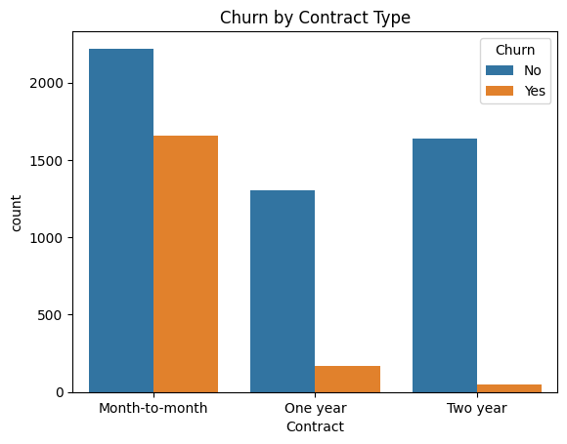
EDA Highlights
1. Churn by Contract Type
73% of churn comes from month-to-month contracts.
Long-term contracts (1-2 years) show 3x lower churn.

Slide 5
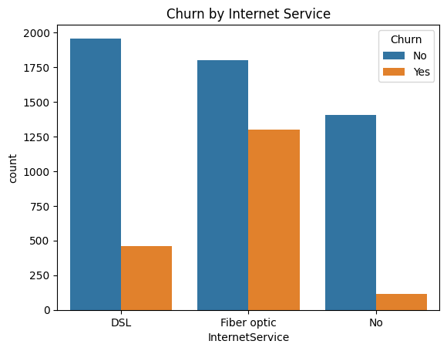
EDA Highlights
2. Fiber Optic Users at Risk
Fiber optic users churn 2x more than DSL users.

Slide 6
EDA Highlights
3. Payment Method Impact
Electronic check users churn 30% more than others.

Slide 7
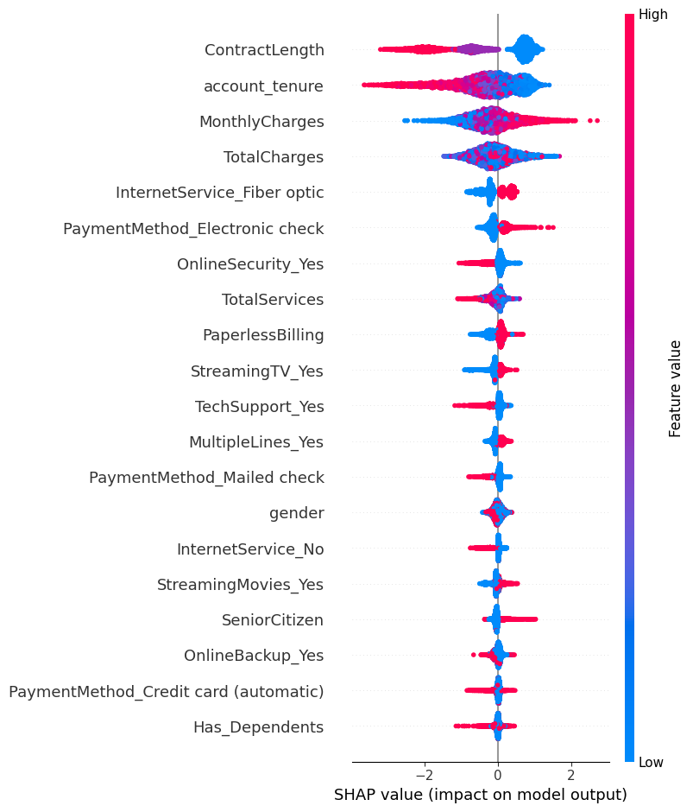
Feature Importance (SHAP Analysis)
SHAP analysis explains XGBoost churn predictions by identifying key factors like monthly charges & contract type, showing their impact on individual customer churn risk.
Top Drivers of Churn:
  Contract type (short-term → high risk).
  Monthly charges (higher → higher risk).
  Fiber optic service.

Slide 8
SHAP Analysis: Key Churn Insights
Contract & Tenure: Short-term contracts and new customers churn more; long-term users are stable.
Charges: High monthly charges drive churn, but long-term customers with high total payments stay.
Internet Service: Fiber users churn more (pricing/service issues); no-internet users churn less.
Payment Method: Electronic check users have higher churn; other methods are more stable.
Security & Support: Online security & tech support reduce churn.
Streaming Services: TV/movie streaming users churn more, likely due to bundle dissatisfaction.
Paperless Billing: Digital-savvy customers opting for paperless billing churn more.
Demographics: Seniors churn slightly more; gender impact is minimal.

Slide 9
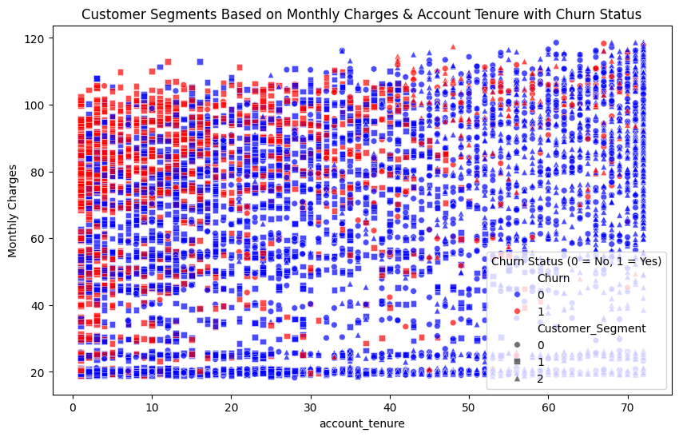
Customer Segmentation
K-Means clustering groups customers based on tenure, charges, and contract type, revealing high-risk churn segments and stable customer groups for targeted retention strategies.
Cluster 0: New, high-paying customers → highest churn risk.
Cluster 2: Long-tenure, moderate spenders → most loyal.

Slide 10
Customer Segmentation & Churn Insights
Tenure & Churn : New customers (short tenure) churn more, especially with high monthly charges.
Monthly Charges : Higher charges correlate with higher churn, possibly due to perceived low value.
Stable Segments : Long-tenure, moderate-charge customers are more satisfied and less likely to churn.
Cluster Insights:
  Cluster 0 (●) : New, high-paying customers with high churn risk.
  Cluster 1 (■) : Moderate-paying customers with mixed tenure and lower churn.
  Cluster 2 (▲) : Long-tenure, moderate-charge customers—most stable & loyal.
Key Takeaway: Reduce churn by improving value for new, high-paying customers and reinforcing loyalty for long-tenure users.

Slide 11
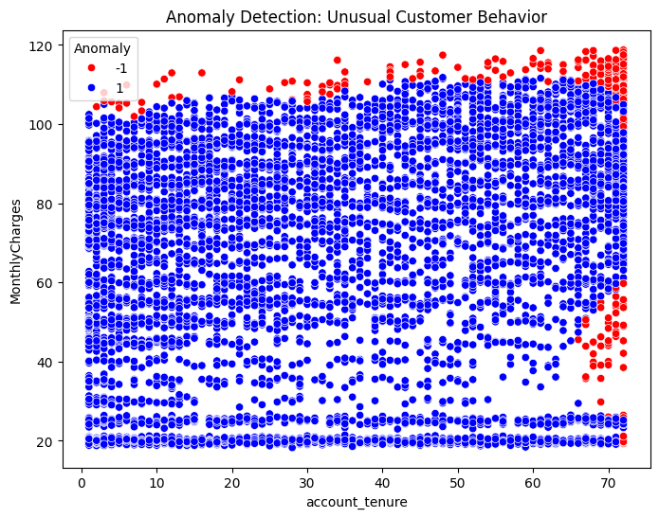
Anomaly Detection Insights
Isolation Forest identifies high-charge or extreme-tenure anomalies as potential churn risks, enabling early intervention through billing adjustments and retention strategies.
5% of customers flagged as anomalies:
  High monthly charges ($100–120) + low tenure (0–12 months).

Slide 12
Anomaly Detection & Churn Insights
High Monthly Charges: Outliers (🔴) cluster at $100-$120, suggesting billing issues or dissatisfaction.
Tenure Extremes:
  Low tenure (0-10 months): Early churn due to cost/service concerns.
  High tenure (60-70 months): Legacy users may face pricing shifts or service changes.
Stable Segments: Most normal customers (🔵) fall in the 10-50 months tenure & $20-$90 charges, showing predictable behavior.
Key Takeaway: Focus retention on new high-paying customers and long-tenured users facing pricing shifts to reduce churn.

Slide 13

Model Performance
Random Forest Classifier: 79% accuracy.
  Precision (Churn): 63% | Recall (Churn): 48%.
  Weakness: Struggles to identify churners (high false negatives).
Why Focus on Recall?
Churn is the Priority
  Recall captures more churners, which is the key to effective retention.
Minimizing Risk
  Prioritizing recall helps prevent missing churners, even if precision is slightly lower.

Slide 14
Business Recommendations
1. Fiber Optic Retention Overhaul
Issue: 31% higher churn risk for fiber users (correlation: 0.31).
Actions:
  Launch "Basic Fiber" tier at lower cost.
  Bundle free premium tech support with fiber plans.
2. Auto-Pay Adoption Campaign
Issue: Electronic check users churn 30% more.
Actions:
  Offer 5% discount for auto-pay enrollment.
  Simplify setup via SMS/email nudges.
3. Contract Conversion Incentives
Issue: 73% of churn from month-to-month contracts.
Actions:
  $100 loyalty bonus for switching to 1-year contracts.
  Free streaming upgrades for early renewals.
4. High-Risk Customer Discounts
Issue: New customers with high charges churn most.
Actions:
  10% off first 6 months for new high-spenders.

Slide 15
Business Recommendations
5. Anomaly Retention Program
Issue: 5% of customers flagged as high-risk anomalies.
Actions:
  Assign dedicated account managers for personalized retention.
6. Streaming Value Partnerships
Issue: Streaming users churn slightly more.
Actions:
  Partner with Netflix/Disney+ for free bundled access.
7. Senior Citizen Engagement
Issue: Seniors churn 15% more.
Actions:
  15% senior discount on bundled services.
8. Real-Time Churn Alerts
Leverage Model Predictions:
  Trigger instant offers (e.g., 20% discount) for flagged high-risk customers.

